Slide 1
Outline
Train 1000 length genes from machine learning
Shap value result
Some problem

Slide 2
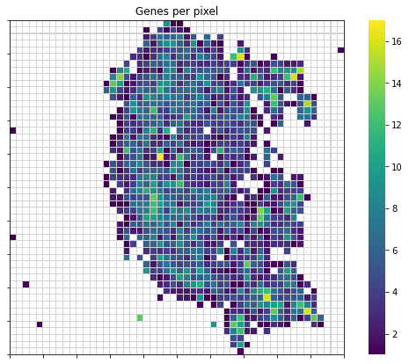
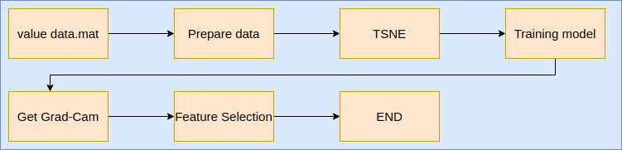
DeepInsight - TSNE matrix

Slide 3
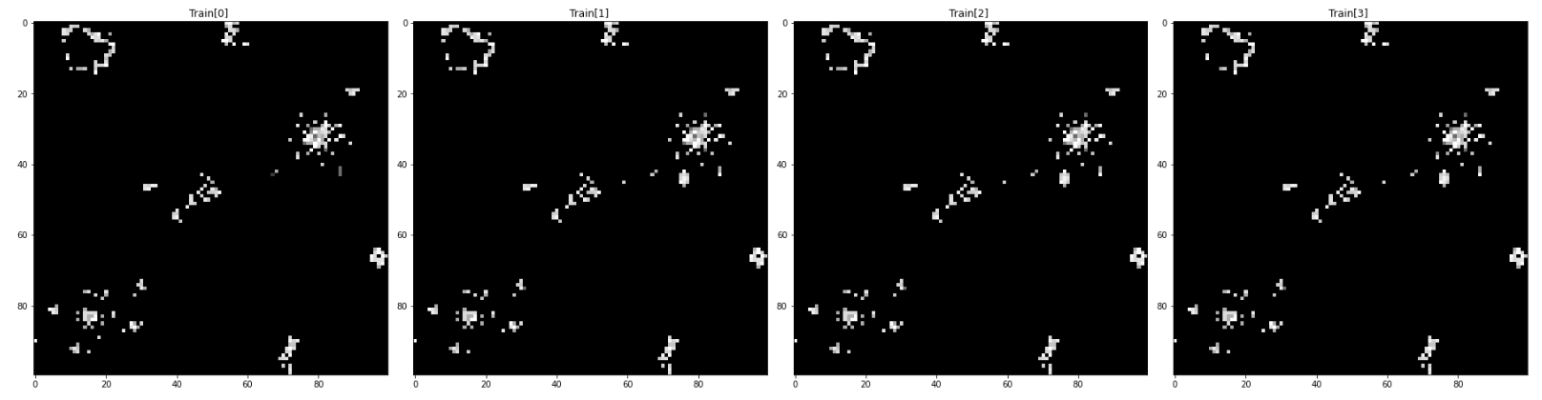
Gene Filter 1000 - DeepInSight 100 pixel

Slide 4
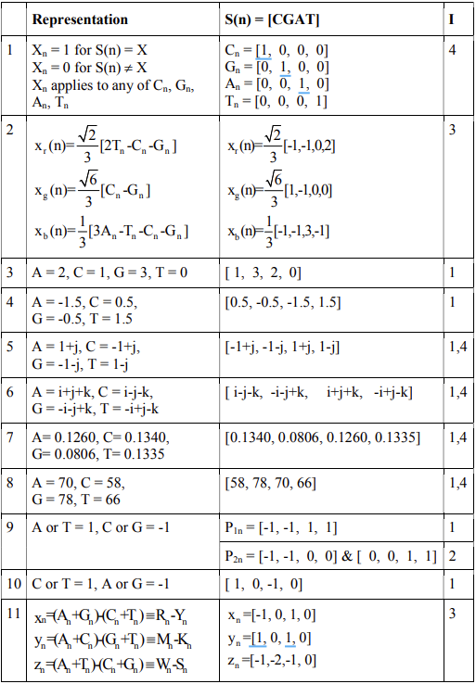
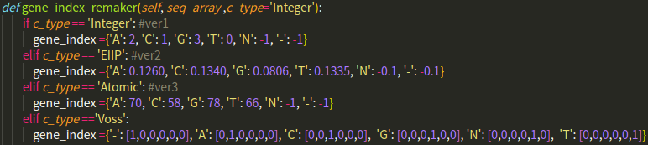
Gene index convert
voss
Integer
EIIP
Atomic

Slide 5
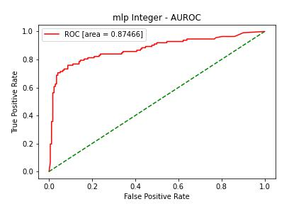
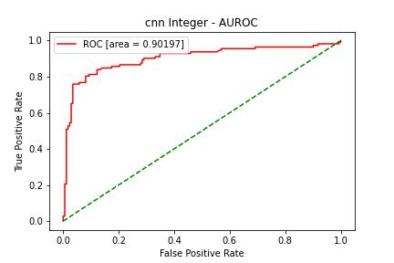
AUROC Result - MLP & CNN(ResNet18) {Integer}

Slide 6
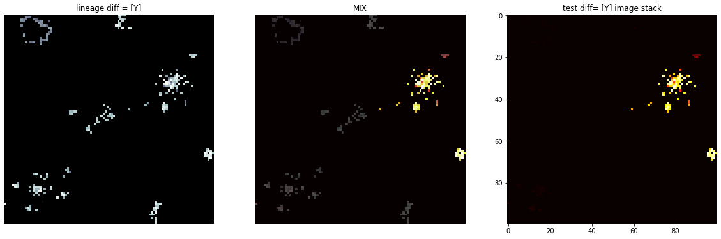
1000 gene len -TSNE GradCam [ths>0.75] {Integer}

Slide 7
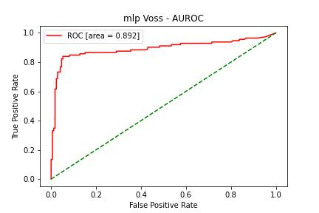
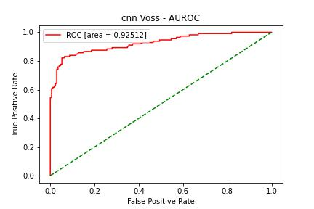
AUROC Result - MLP & CNN(ResNet18) {onehot [voss]}

Slide 8
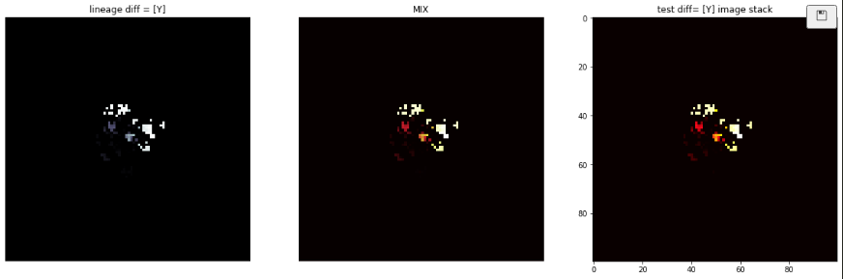
1000 gene len -TSNE GradCam [ths>0.75] {onehot [voss]}

Slide 9
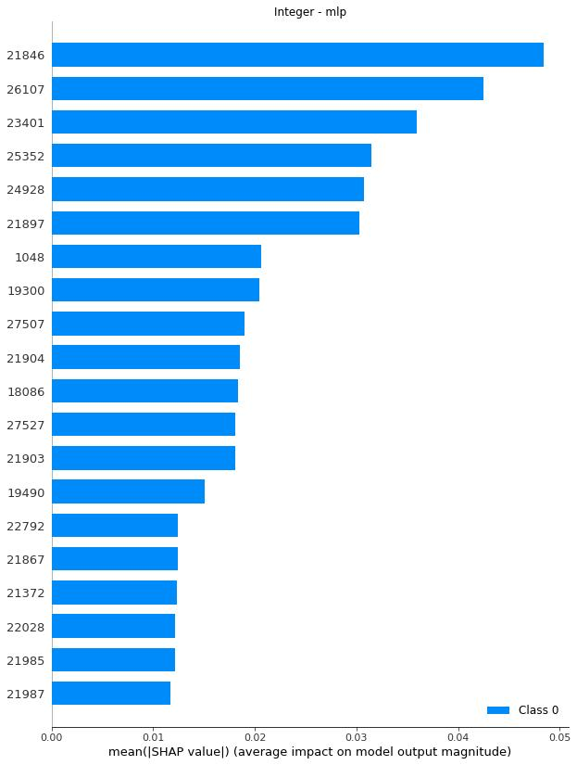
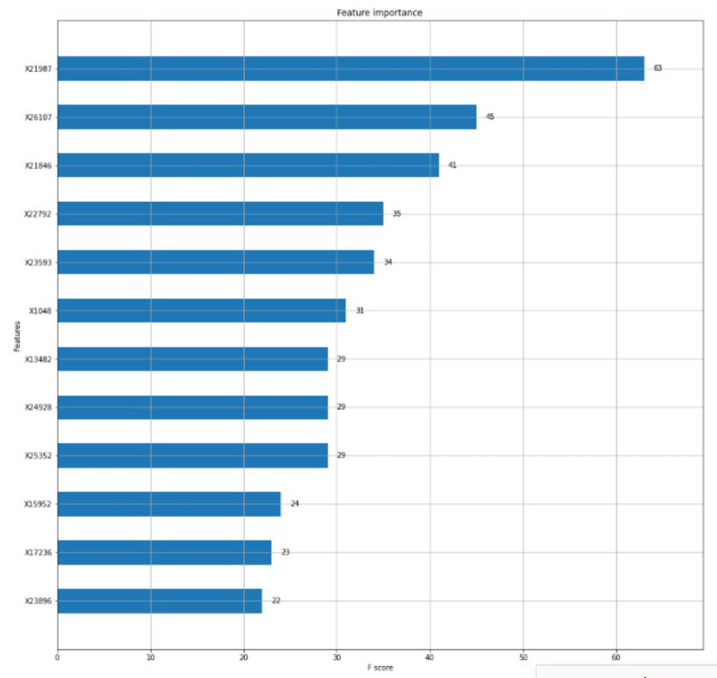
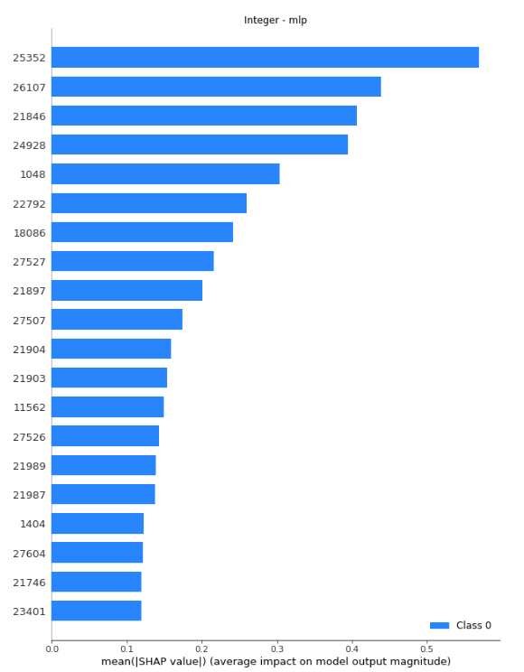
1000 gene len - MLP & Machine Learning {Integer}
21987
26107
21846
22792
23593
1048
13482
24928
25352
15952
17236
23896
Notes:
bruta

Slide 10
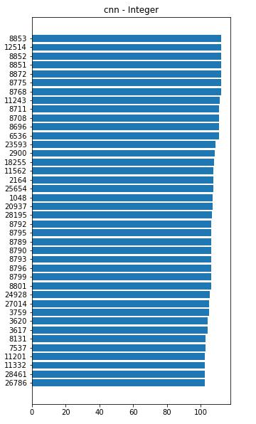
1000 gene len - MLP & CNN Feature Important {Integer}

Slide 11
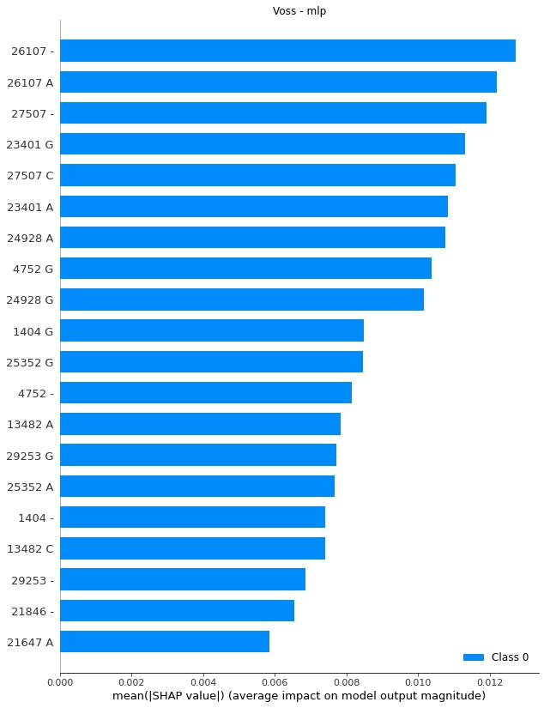
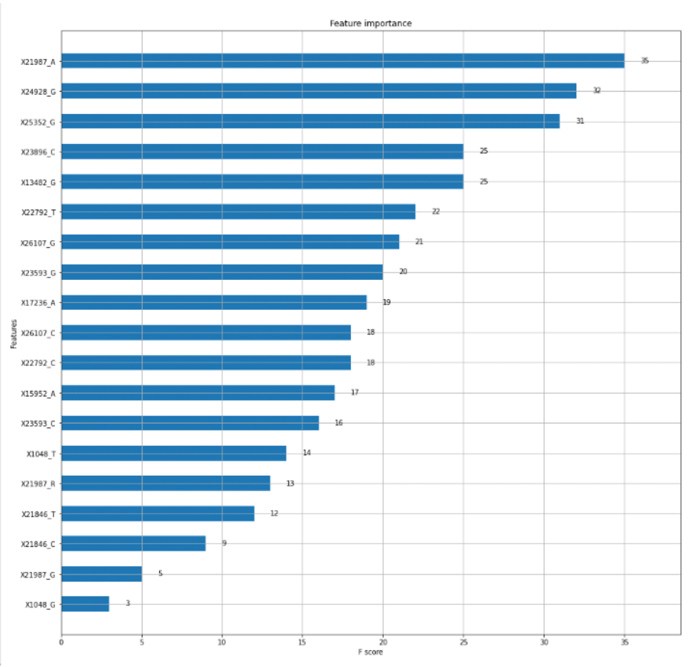
1000 gene len - MLP & Machine Learning {onehot [voss]}
21987-A
24928-G
25352-G
23896-C
13482-G
22792-T
26107-G
23593-G
17236-A
26107-C
22792-C
15952-A
23593-C
1048-T
21987-R
21846-T
21846-C
21987-G
1048-G

Slide 12

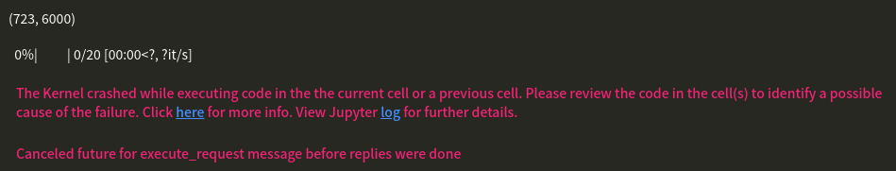


Some problem - 1000 length genes
One hot - out of memory (RAM)
One hot - out of memory (CPU)
Solution
Notes:
batch learning

Slide 13
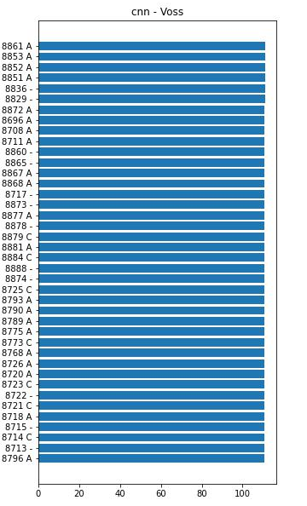
Some problem - 1000 length genes
One hot - Feature Important

